Slide 1
Fractal Dimension For Thick Cross Sections

Slide 2
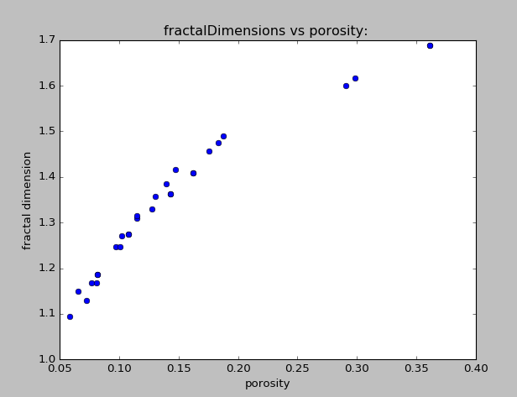

Slide 3
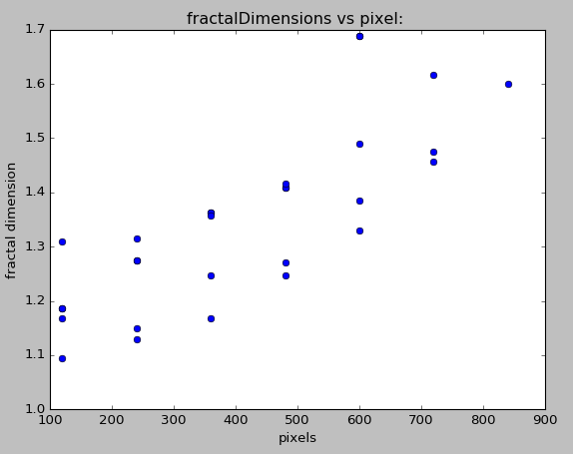

Slide 4
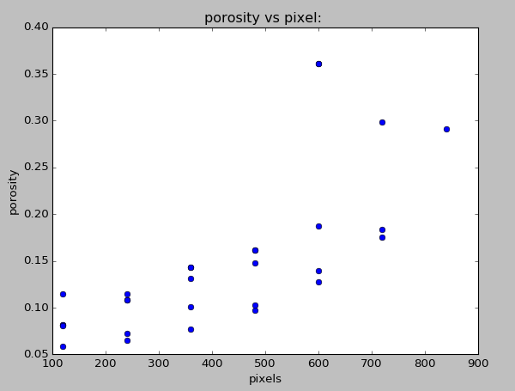

Slide 5
